Slide 1
Special Agricultural Homesteads Establishing, Linking, and Much More…
Jessi Glancey – DOR
Jon Klockziem – DOR
Doug Bruns – Ag Committee Chair
Karl Lindquist – Ag Committee Member

Slide 2
Agenda
Time | Topic
1:00 | Welcome
1:15 | Introduction to Special Agricultural Homesteads
2:00 | Establishing Special Agricultural Homestead
2:30 | Break
2:45 | Linking
3:15 | Important Requirements
3:30 | Case Studies
4:45 | Wrap UP

Slide 3
Introductions
Jessi Glancey – DOR for 6 ½ years, Education Coordinator
Jon Klockziem – DOR for 4 years, Assistant Director,
Doug Bruns – Renville County Assessor & MAAO Ag Committee Chair
Karl Lindquist – Grant County Assessor & MAAO Ag Committee Member
Notes:
Everyone stand up:
Sit down if you don’t have any agricultural land in your county
If someone sits, ask them if they are in the right class
Sit down if you only have owner occupied agricultural land in your county
Sit down if you have less than 50 agricultural parcels in your county
Sit down if you have less than 100 agricultural parcels in your county
Sit down if you have been working with agricultural homestead for 5 years or less
Sit down if you have been working with agricultural homesteads for 8 years or less
People standing are the experts in the room, ask which counties they are from.

Slide 4
Objectives and Class Rules
No County Specific Scenarios
Be Respectful (technology, comments etc…)
Participate
Objectives:
Understand the “formula” for determining special agricultural homesteads.
Define important terms associated with agricultural homesteads.
Explain the differences between agricultural homesteads and special agricultural homesteads, including establishing and linking.
Analyze case studies and determine if the property qualifies for agricultural homestead.

Slide 5
Let the Games Begin!
Fill In the Blank!!!!
An ________________ can be an individual, entity, or a trust.
The first step in determining agricultural homestead is to _____________ homestead on one parcel of ag land.
When ag land is unoccupied, the ________________ plays a very important role when determining ag homestead.
Once ag homestead has been ______________ then other noncontiguous parcels can be reviewed for __________________.
A ___________ parcel is established when an owner/relative of the owner occupies the property.
owner
establish
farmer
established
linking
base

Slide 6
Let the Games Begin!
Fill In the Blank!!!!
When an owner of ag land lives in town and not on the farm, that property in town is classified as ____________. It is not classified as __________ .
The ____________ _________ parcel must be determined when reviewing unoccupied ag parcels for homestead.
Use the determining ag homestead ________________, when you are _________________ ag homestead.
A property must be ______________ to qualify for an agricultural homestead. When a property is ________________, it would qualify for a special agricultural homestead.
Use the homestead __________ ____________ after you’ve established homestead on an individual parcel.
residential
“resi – ag”
established
main
flowchart
establishing
occupied
unoccupied
linking
checklist

Slide 7
Ag homestead vs. Special Ag Homestead
Ag homestead | Special Ag Homestead
Property is occupied | Property is unoccupied* *in most cases
Who farms is not a factor! | Who farms is a factor, a BIG one!
Linking = base parcel | Linking = established main parcel
Agricultural homestead can be linked to any other non-contiguous 2a agricultural land that is: owned by the same owner and located within 4 cities/townships from the base parcel | Special agricultural homestead can be linked to any other non-contiguous 2a agricultural land that is: owned by the same owner and a qualified person must be farming and the parcel is at least 40 acres the owner and qualified person actively farming lives within 4 cities/townships of the agricultural property

Slide 8
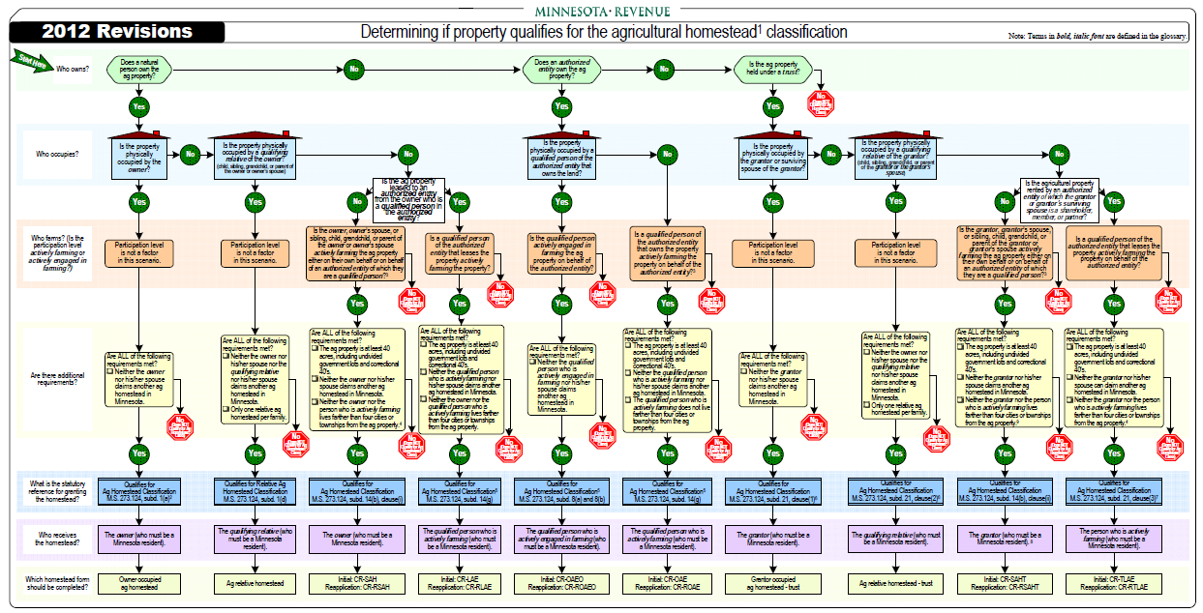
Establishing Special Agricultural Homestead
What tool should we use when establishing agricultural homestead????
Notes:
Take out your flow charts. This can be found on our website.

Slide 9
Establishing Special Agricultural Homestead
The flow chart was developed to simplify the process and is based on these basic questions:
Who Owns?
Who Occupies?
Who Farms?
Notes:
We have tried to simplify by developing a flow chart that is based on three basic questions

Slide 10
Special Agricultural Homestead
What makes it special?
It is called a “special” agricultural homestead because no one occupies the property.
It also must meet specific requirements:
Minimum size (40 acres)
Where the owner(s) live (within 4 cities and/or townships)
Who is farming, and how much?
Notes:
When no one occupies, we care about who farms, and whether the person is “actively farming”

Slide 11
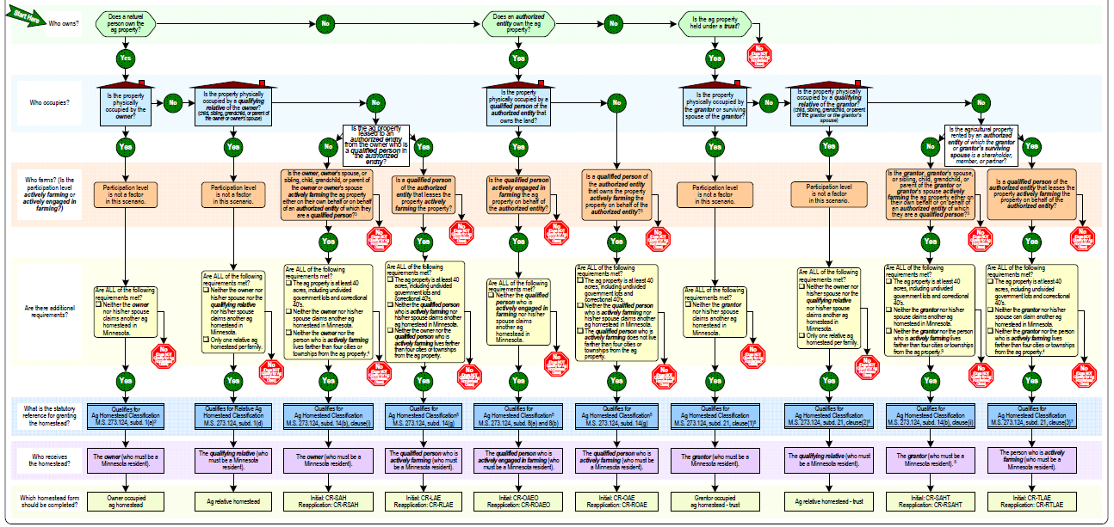
Establishing Special Agricultural Homestead

Slide 12
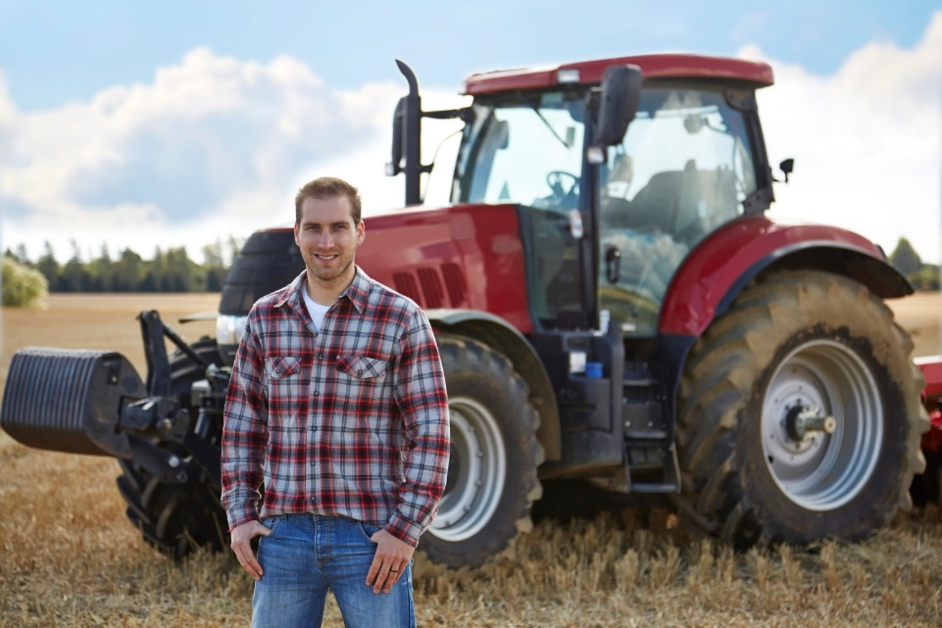
Establishing Special Agricultural Homestead
What is “actively farming”?
Applies when no one lives on the farm
Requires a greater degree of participation
Requires a share in any profits or losses
The person must participate in the day-to-day decision-making and labor
The person must contribute to the administration and management of the farming operation

Slide 13
Is the ag property leased to an authorized entity?
Is the owner a qualified person of the authorized entity?
Is the ag property leased to an authorized entity?
Is the grantor or spouse a shareholder, member or partner?

Slide 14
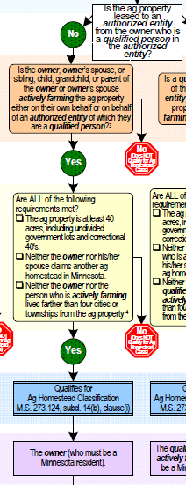
Establishing Special Agricultural Homestead
Important things to note about establishing under column #3
If not the owner, the “farmer” must be a qualifying relative
No nephews, nieces, aunts, uncles or grandparents
Farmed on behalf of an entity-must again be a qualifying relative
Since the owner receives the homestead, the active farmer (who is not the owner or spouse) is eligible for their own agricultural homestead
Most common special ag homestead
6,140 count from 2014 survey

Slide 15
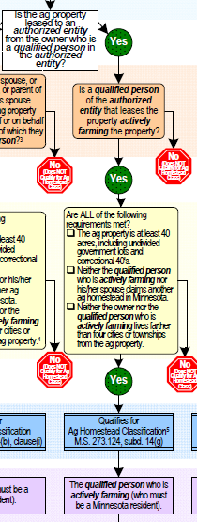
Establishing Special Agricultural Homestead
Important things to note about establishing under column #4
Both the owner and qualified person must be members, partners, or shareholders of the leasing entity
Multiple qualified persons of the entity may establish homestead
The qualified person who is actively farming receives the homestead
The owner may establish his/her own homestead
Less frequent only 498 granted (2014 survey)

Slide 16
Establishing Agricultural Homestead
Important things to note about establishing under column #5
The qualified person must reside on and participate in the farm (actively engaged)
This is the only actively engaged requirement
Most entities will need to be registered with the Minnesota Department of Agriculture to receive homestead
Up to 12 homesteads may be granted for entity owned land
Beyond the minimum 10 acre in production, there is no 40 acre requirement

Slide 17
Establishing Special Agricultural Homestead
Important things to note about establishing under column #6
Anyone in the entity can be actively farming
This also can have up to 12 qualifying homesteads
An entity cannot farm on behalf of the ownership entity
Small number only 398 homesteads

Slide 18
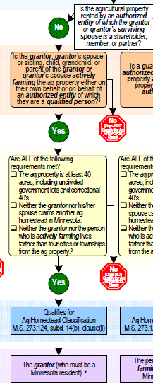
Establishing Special Agricultural Homestead
Important things to note about establishing under column #9
If not the grantor or grantor’s surviving spouse, the “farmer” must be a qualifying relative
No nephews, nieces, aunts, uncles or grandparents
Farmed on behalf of an entity-must again be a qualifying relative
Since the grantor receives the homestead, the active farmer (who is not the grantor or surviving spouse) is eligible for their own agricultural homestead
807 count 2014 survey
Deceased grantors can qualify for homestead if all requirements are met

Slide 19
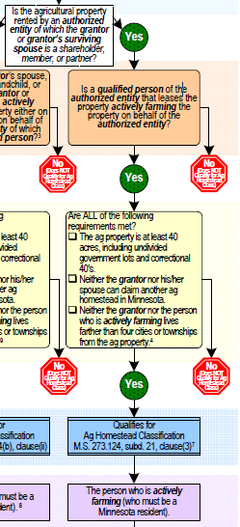
Establishing Special Agricultural Homestead
Important things to note about establishing under column #10
Both the grantor and qualified person must be members, partners, or shareholders of the leasing entity
Multiple qualified persons of the entity may establish homestead
The qualified person who is actively farming receives the homestead
The grantor may establish his/her own homestead
Least frequent only 65 granted (2014 survey)
Notes:
This needs to be reviewed and updated.

Slide 20
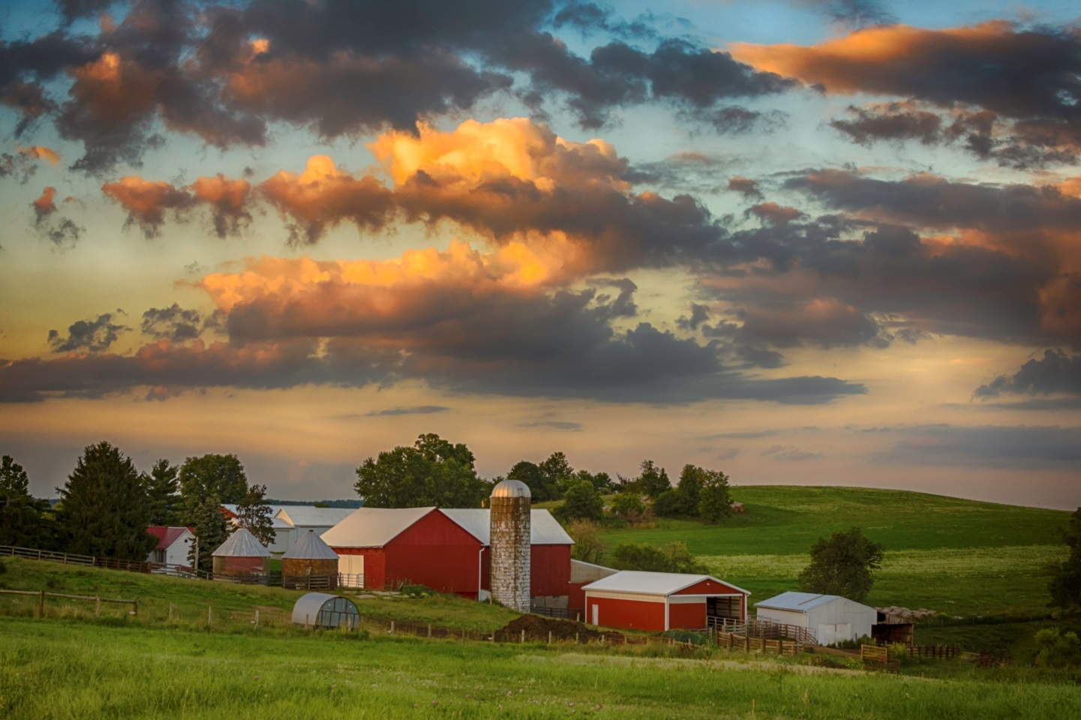
Linking Agricultural Homestead
Linking Ag Homestead
Establish where the house is = base parcel
Other non-contiguous ag parcels owned by the same owner as the base parcel can be linked for homestead
Base parcel must be within 4 cities/townships of the non-contiguous parcels
The farmer of the base parcel and/or the non-contiguous parcels doesn’t matter
Linking Special Ag Homestead
Establish on one parcel = established main parcel
Other non-contiguous ag parcels owned by the same owner as the established main parcel can be linked for homestead
Established main parcel must be within 4 cities/townships of the non-contiguous parcels
The farmer for each non-contiguous parcel must be reviewed
Notes:
Differences in addition to the ones listed:
Ag homestead only thing that matters is classification, ownership and location
Special ag homestead: must be 40 acre tracts, must be ag,

Slide 21
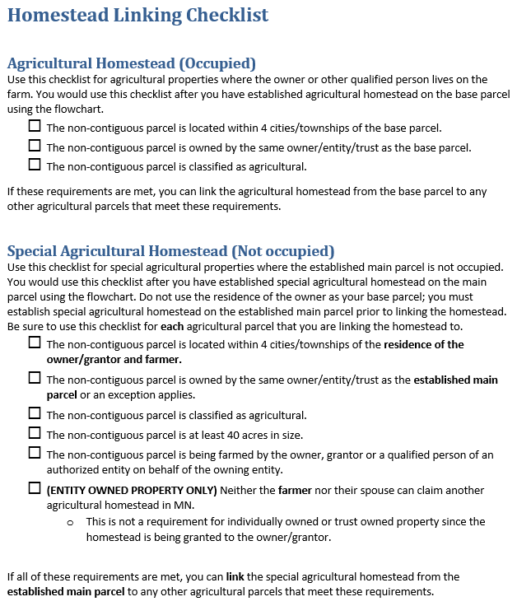
Linking Agricultural Homestead
When linking ag homestead, put the flowchart away!
Use the Homestead Linking Checklist!

Slide 22
Linking Special Agricultural Homesteads
Requirements:
The agricultural parcel is under the same ownership as the established main parcel.
A qualified person* must be farming the land on behalf of the owner.
*qualifying relative of owner/grantor/shareholder/member of an entity
The agricultural parcel is at least 40 acres.
If an established main parcel is leased for farming purposes and a qualified person of the entity is farming, then all other non-contiguous parcels must be farmed by that same entity and farmer.
The owner/grantor and the qualified person actively farming lives within 4 cities/townships of the agricultural property.

Slide 23
Linking Special Agricultural Homesteads
Exceptions
Established main parcel owned by an individual can be linked to an agricultural parcel owned by the individual and other individuals.
Established main parcel owned by an individual can be linked to an agricultural parcel owned by a trust where the same owner is the grantor.
Established main parcel owned by one spouse can be linked to an agricultural parcel owned by the other spouse (no entities).

Slide 24
Linking Special Agricultural Homesteads
4 Cities/Townships Rule
1
3
X
Established Main Parcel
Township 1
Township 3
Township 5
2
4
Township 2
Township 4
City A

Slide 25
Linking Special Agricultural Homesteads
4 Cities/Townships Rule
Established Main Parcel
X
1
3
Township 1
Township 3
Township 5
City A
4
Township 2
Township 4
2

Slide 26
Linking Special Agricultural Homesteads
4 Cities/Townships Rule
Established Main Parcel
1
X
3
Township 1
Township 3
Township 5
City A
4
2
Township 2
Township 4

Slide 27
Linking Special Agricultural Homesteads
4 Cities/Townships Rule
2
Established Main Parcel
City A
1
4
Township 1
Township 3
Township 5
Township 2
Township 4
3

Slide 28
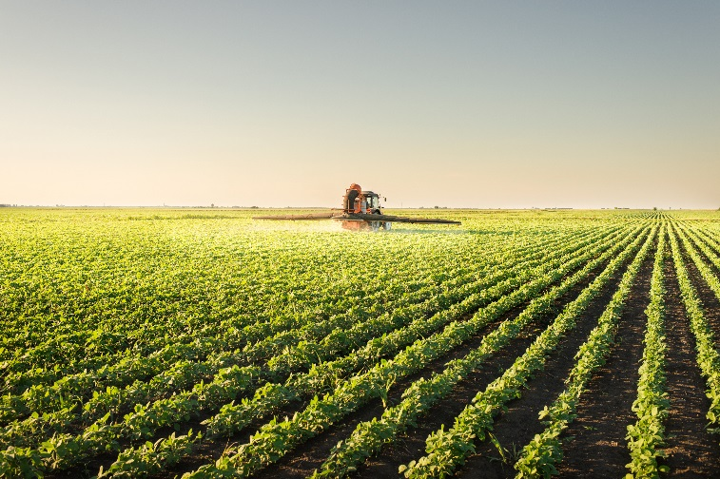
Linking Special Agricultural Homesteads
If established main parcel…. | Then…
Is leased and a qualified person is farming | All non-contiguous parcels must be farmed by that same farmer
Is not leased, but the non-contiguous parcels are leased | Special ag homestead linking should be denied
Established Main Parcel
Farmed by a relative of the owner
Cannot Link
Non-Contiguous Parcel
Leased to an entity for farming
Notes:
When a parcel is leased to an authorized entity for farming purposes, special agricultural homestead linking should be denied if the established main parcel is not leased to the same farming entity. If the established main parcel is leased for farming purposes, parcels leased to the same authorized entity and that have the same qualified person actively farming as the established main parcel may be linked.

Slide 29
Linking Special Agricultural Homesteads
Step 1: Establish the agricultural homestead
Do not use the owner/farmers residential property as the established main parcel.
It has always been the DOR’s recommendation that the agricultural parcel that is the most contiguous parcel to the residence of the owner and farmer, should be the established main parcel.
Step 2: Review all non-contiguous parcels owned by the same owner as the established main parcel for linking. All requirements must be met for each parcel!
Step 3: Link the parcels! Each non-contiguous parcel that meets the linking requirements can be linked for homestead purposes.

Slide 30
Linking Special Agricultural Homesteads
Important Requirements
When linking special agricultural homestead, you should be linking from the established main parcel, not the owner’s residence.
Use the residence of the owner and active farmer when determining whether the agricultural parcels are within 4 cities/townships.
Do not use the agricultural homestead flowchart for linking property; it is only used for establishing homestead

Slide 31
Linking Special Agricultural Homesteads
Important Requirements
When a property is owned by an entity and is unoccupied, each qualifying member that is actively farming can receive their own special agricultural homestead, up to 12 homesteads for the entity.
When a special agricultural homestead is granted to the active farmer, you must verify whether that farmer is claiming another agricultural homestead in MN prior to establishing and/or linking.
The same rules for linking agricultural homestead apply to special agricultural homestead around ownership interest.

Slide 32
Let’s try one!
Rachel owns two separate 40 acre parcels of farmland that she does not live on.
She lives with her mother, in her mother’s house within 4 townships of her property.
Both parcels are farmed by R&R Farms, Rachel is not part of the farming entity.
R&R Farms is made up of Rachel’s mom and brother.
There is no formal lease agreement between the owner and entity, since they are family.
Her brother lives next door to his mom.
Her mother files for special ag homestead on her individually owned ag properties.
Her brother files for special ag homestead on his individually owned ag properties.
Do either of the parcels qualify for special agricultural homestead?

Slide 33
Let’s try one!
Yes!
Remember the three steps!
Step 1: Establish (using the __________________)
Using the closest parcel, let’s use parcel 1.
Who owns:
Who occupies:
Who farms:
Parcel is at least 40 acres in size
Rachel does not claim another ag homestead in MN
Rachel and the farmers live within 4 townships of parcel 1.
Flowchart!
Rachel
What column are we looking at????
Nobody
R&R Farms (Rachel’s mom and brother)
Rachel!
Does parcel 1 qualify for special ag homestead????
Who gets the homestead?

Slide 34
Let’s try one!
Remember the three steps!
Step 2: Review (using the ________________________)
Now take a look at parcel 2
Is the parcel located within 4 cities/townships of the residence of the owner and farmers?
Is the parcel owned by the same owner as the established main parcel?
Is the parcel classified as agricultural?
Is the parcel at least 40 acres?
Is the parcel being farmed by a qualified person/persons on behalf of the owner?
Checklist!
Yes
Yes
Yes
Yes
Yes

Slide 35
Let’s try one!
Remember the three steps!
Step 3: Link
Can the special agricultural homestead be linked from the established main parcel to parcel 2????
Yes!
Who gets the homestead?
Rachel!

Slide 36
Thank you!
Firstname Lastname
firstname.lastname@state.mn.us
555-555-5555

